Slide 1
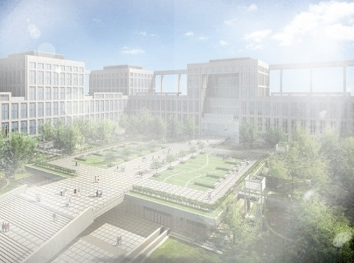
Mining High Utility Itemsets over Uncertain Databases
Yuqing Lan [1], Yang Wang [1],
Yanni Wang [2], Shengwei Yi [3] and Dan Yu [4]
[1] School of Computer Science and Engineering, Beihang University
[2] School of Software, Beihang University
[3] China Information Technology Security Evaluation Center
[4] China Standard Software Co. Ltd
Reporter: Yang Wang

Slide 2
Presentation Outline
Introduction
Problem Statement
UHUI-Apriori Algorithm
Experimental Evaluation
Conclusion

Slide 3
Introduction

Slide 4
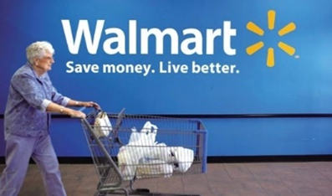
Introduction
Deterministic Transaction Database
 | Book Data Mining | Mobilephone iPhone 6s | Food Bread | Fruit Banana | Vegetable Tomato | Meat Chicken | … | Drink Coke
Customer 1 | × | × | √ | √ | √ | × | … | √
Customer 2 | × | × | √ | × | √ | √ | … | √
…
The merchants maybe interested to find the following associations between different goods in supermarket.
Bread => Coke
These associations are very useful information to assist merchant develop sales strategy.
Coke => Tomato + Bread
Coke => Tomato
Mining frequent itemsets is an essential step in association analysis.

Slide 5
Introduction
Deterministic Transaction Database
 | Book Data Mining | Mobilephone iPhone 6s | Food Bread | Fruit Banana | Vegetable Tomato | Meat Chicken | … | Drink Coke
Customer 1 | 0 | 1 | 10 | 5 | 22 | 40 | … | 30
Customer 2 | 0 | 0 | 15 | 30 | 40 | 20 | … | 48
…
A Utility Table
 | Data Mining | iPhone 6s | Bread | Banana | Tomato | Chicken | … | Coke
Value(profit) | 12 | 500 | 8 | 2 | 1 | 5 |  | 1.5
The merchants maybe interested to find the associations which goods can be more than 200 yuan together.
Bread => Chicken
These associations are more useful information to assist merchant develop sales strategy.
Bread => Tomato + Chicken
Chicken => Banana + Tomato
Mining high utility itemsets is an essential step in association analysis.

Slide 6
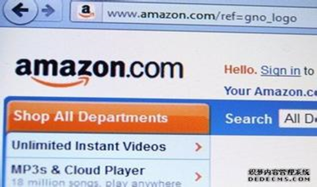
Introduction
Uncertain Transaction Database
 | Laptop MacBook Pro | Mobilephone iPhone 6s | Pad iPad | Fruit Banana | Vegetable Tomato | Meat Chicken | … | Drink Coke
Customer 1 | 95% | 90% | 95% | 40% | 95% | 19% | … | 50%
Customer 2 | 91% | 90% | 90% | 12% | 85% | 70% | … | 98%
…
A Utility Table
 | MacBook Pro | iPhone 6s | iPad | Banana | Tomato | Chicken | … | Coke
Value(profit) | 1200 | 500 | 300 | 2 | 1 | 5 |  | 1.5
In e-commerce, the existence of an item in a transaction is best captured by a likelihood measure or a probability.
The storekeeper maybe interested to find the associations which goods probably can bring large profit together.
MacBook Pro => iPhone 6s
These associations are much more useful information to assist merchant develop sales strategy.
iPhone 6s => iPad
iPad => MacBook Pro + iPhone 6s

Slide 7



Existential Uncertain Databases
Existential Uncertain Dataset
 | Item 1 | Item 2 | ……
Transaction 1 | 90% | 85% | ……
Transaction 2 | 60% | 5% | ……
……
Recommender
Value Table
 | Item 1 | Item 2 | ……
Value | 2 | 3 | ……
An existential uncertain databases is a transaction dataset in which each item is associated with an existential probability and each item has a value.
Other applications of existential uncertain databases
  Recommender: Youtube、Hulu

Slide 8
Problem Statement
The definition of high utility itemsets over uncertain databases

Slide 9
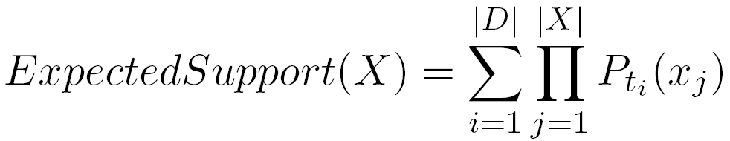
Mining High Utility Itemsets over Uncertain Databases
Existential Uncertain Dataset
 | Item 1 | Item 2 | ……
Transaction 1 | 90% | 85% | ……
Transaction 2 | 60% | 5% | ……
……
Value Table
 | Item 1 | Item 2 | ……
Value | 2 | 3 | ……
ExpectedUtility (X) = ExpectedSupport (X) × Value (X)

Slide 10
Mining High Utility Itemsets over Uncertain Databases
Problem Definition
  Given an existential uncertain dataset D with each item of a transaction associated with an existential probability, each item has a value, and a user-specified utility threshold u, return ALL the itemsets having expected utility greater than or equal to |D|× u.

Slide 11
UHUI-Apriori Algorithm
A modified Apriori algorithms for uncertain databases

Slide 12
The Classical Apriori Algorithm
For Example :Threshold=2
Itemset | Sup
{A} | 2
{B} | 3
{C} | 3
{D} | 1
{E} | 3
TID | Transaction
10 | A, C, D
20 | B, C, E
30 | A, B, C, E
40 | B, E
I | Sup
{A} | 2
{B} | 3
{C} | 3
{E} | 3
C₁
FI₁
C₂
I | Sup
{A, B} | 1
{A, C} | 2
{A, E} | 1
{B, C} | 2
{B, E} | 3
{C, E} | 2
I
{A, B}
{A, C}
{A, E}
{B, C}
{B, E}
{C, E}
FI₂
I | Sup
{A, C} | 2
{B, C} | 2
{B, E} | 3
{C, E} | 2
C₂
C₃
I
{B, C, E}
FI₃
I | Sup
{B, C, E} | 2

Slide 13
UHUI-Apriori Algorithm
Item | A、B、C、D
Utility | 1、1、1、2
For Example : Threshold=3
TID | TWU
10 | 1.5
20 | 3.2
30 | 0.7
40 | 1.9
Item | U | TWU
{A} | 1 | 2.2
{B} | 2 | 5.8
{C} | 1.7 | 3.7
{D} | 2.6 | 5.1
TID | Transaction
10 | A(0.7), C(0.8)
20 | B(0.7), C(0.9), D(0.8)
30 | A(0.3), B(0.4)
40 | B(0.9), D(0.5)
Itemset
{A, B}
{A, C}
{B, C}
{B, D}
{C, D}
I | U | TWU
{A、B} | 0.7 | 0.7
{A、C} | 1.5 | 1.5
{B、C} | 1.6 | 3.2
{B、D} | 4.2 | 5.1
{C、D} | 2.5 | 3.2
I
{B, C}
{B, D}
{C, D}
Itemset
{B, C, D}
I | U
{B, C, D} | 3.2

Slide 14
Experimental Evaluation

Slide 15
Experimental Environment
A PC with an Core i5-3460 processor and 4GB of RAM.
C++ 、Visual Studio 2010 and 64bit Windows 7 OS.
CHARATERISTICS OF USED DATASETS
Database | |D| | |I| | AvgLen | MaxLen | Type
accidents | 340183 | 468 | 33.8 | 51 | dense
T10I4D100K | 100000 | 870 | 10.1 | 29 | spare

Slide 16
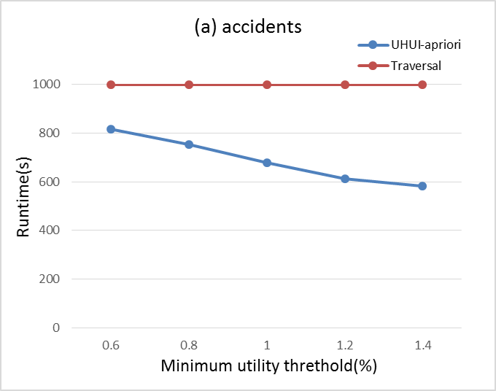
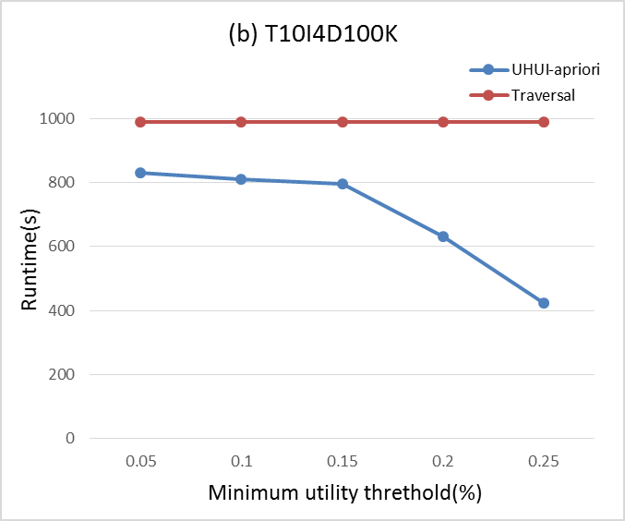
Running time

Slide 17
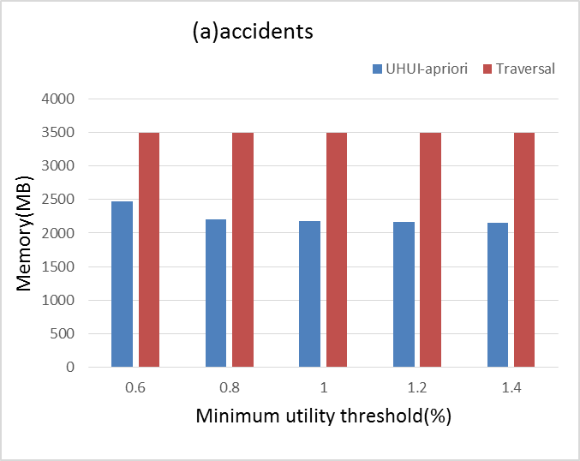
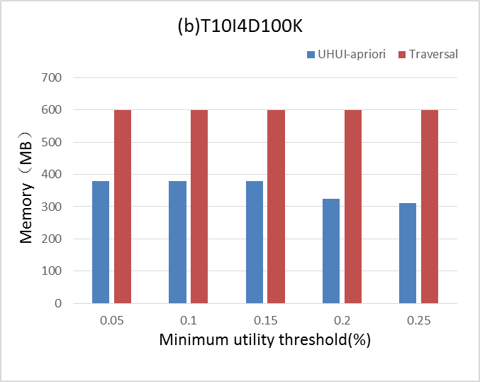
Memory Comsumption

Slide 18
Conclusions

Slide 19
Conclusions
A UHUI-Apriori algorithm is proposed for mining high utility itemsets over uncertain databases.
UHUI-Apriori algorithm is better than the algorithm of direct traversal in both running time and memory consumption.

Slide 20
Thank you !

